Slide 1
Cyclistic bike-share case study
By
Akanbi abdulahi
2024

Slide 2

business tasks
The primary business task is to determine how annual members and casual riders use Cyclistic bikes differently. The insights from this analysis will inform a new marketing strategy aimed at converting casual riders into annual members, leading to a more stable and profitable customer base.

Slide 3
Context
Cyclistic has a diverse customer base with a flexible pricing model that includes single-ride passes, full-day passes, and annual memberships. Finance analysts have determined that annual members are more profitable than casual riders, indicating that a shift towards more annual memberships could positively impact Cyclistic's revenue. The marketing team, therefore, aims to understand the behavioral patterns of these two customer groups to design effective marketing campaigns for converting casual riders into annual members.

Slide 4

Desired Outcome
The desired outcome is to gain actionable insights into how casual rides and annual members differ in their usage patterns of Cyclistic bikes.
Trend in rides
Preferred Ride time
Trends
Bahaviours
Rider behaviours
Patterns of rides
Cyclistic
These insights will form the basis of targeted marketing strategies that promote annual memberships, thereby increasing the company’s profitability and customer retention.
Patterns
Preferences

Slide 5
Cyclistic Marketing Analysis
The primary business task is to determine how annual members and casual riders use Cyclistic bikes differently.
Customers who purchase single -ride or full-day passes are referred to as casual riders.
Customers who purchase annual membership are referred to as members.
Casual
Riders
Member
There are the two types of riders that cyclists bike has.

Slide 6

Data Source
The data used for the analysis was extracted from the Divvy 2019 Q1 and Divvy 2020 Q1.
The data has been made available by Motivate International Inc. and it was provided under the data licence data agreement. Bikeshare hereby grants a non-exclusive, royalty-free, limited, perpetual license to access, reproduce, analyze, copy, modify, distribute in your product or service and use the Data for any lawful purpose (“License”).

Slide 7
Data Cleaning
The data from the two different files were merged. After comparing the names of the columns in the two files, I have renamed columns to make the one in q1_2019 consistent with q1_2020 (as this will be the supposed going-forward table design for Divvy). After merging the two files, I removed some columns that are irrelevant.
date
memeber_
casual
started_at
ended_at
ride_id
rideable_type
start_station_id
Removed Columns:
start_lat, start_lng, end_lat, end_lng, birthyear, gender
Added Columns:
date, month, day, year, ride_lenght
end_station_id
end_station_name

Slide 8
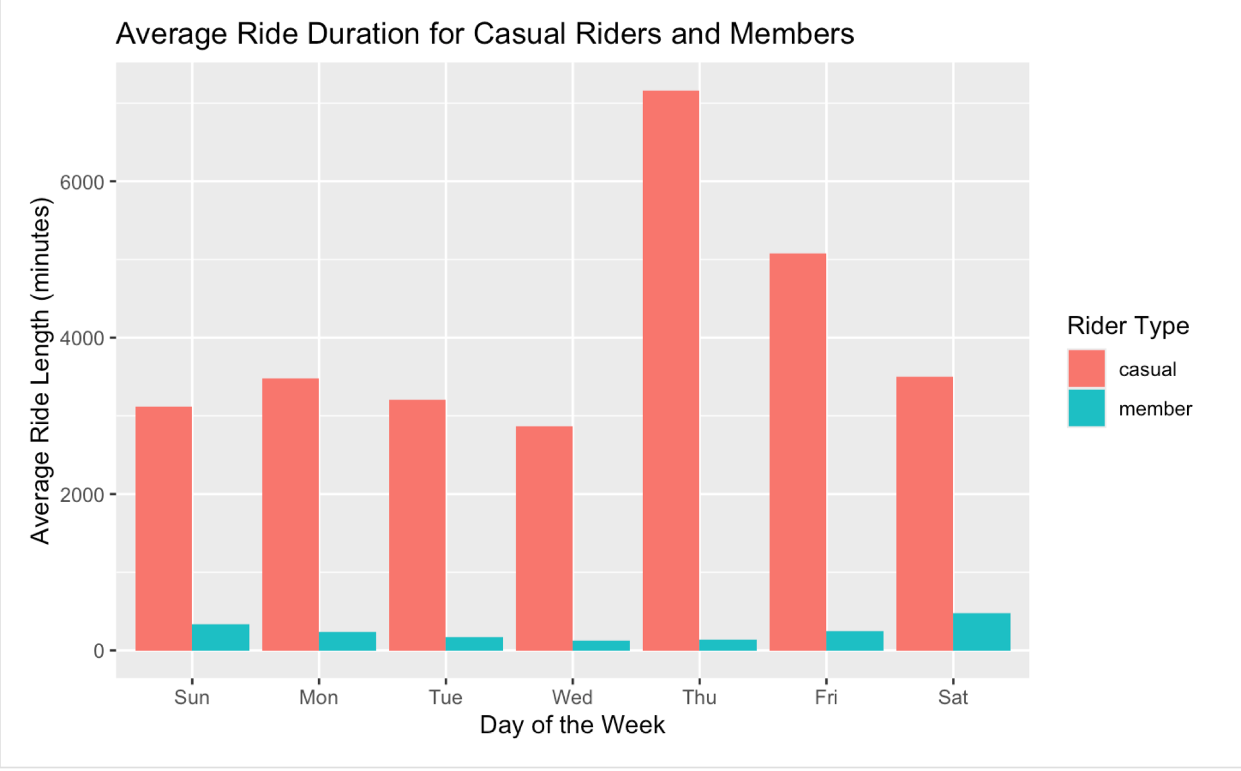
Chart

Slide 9
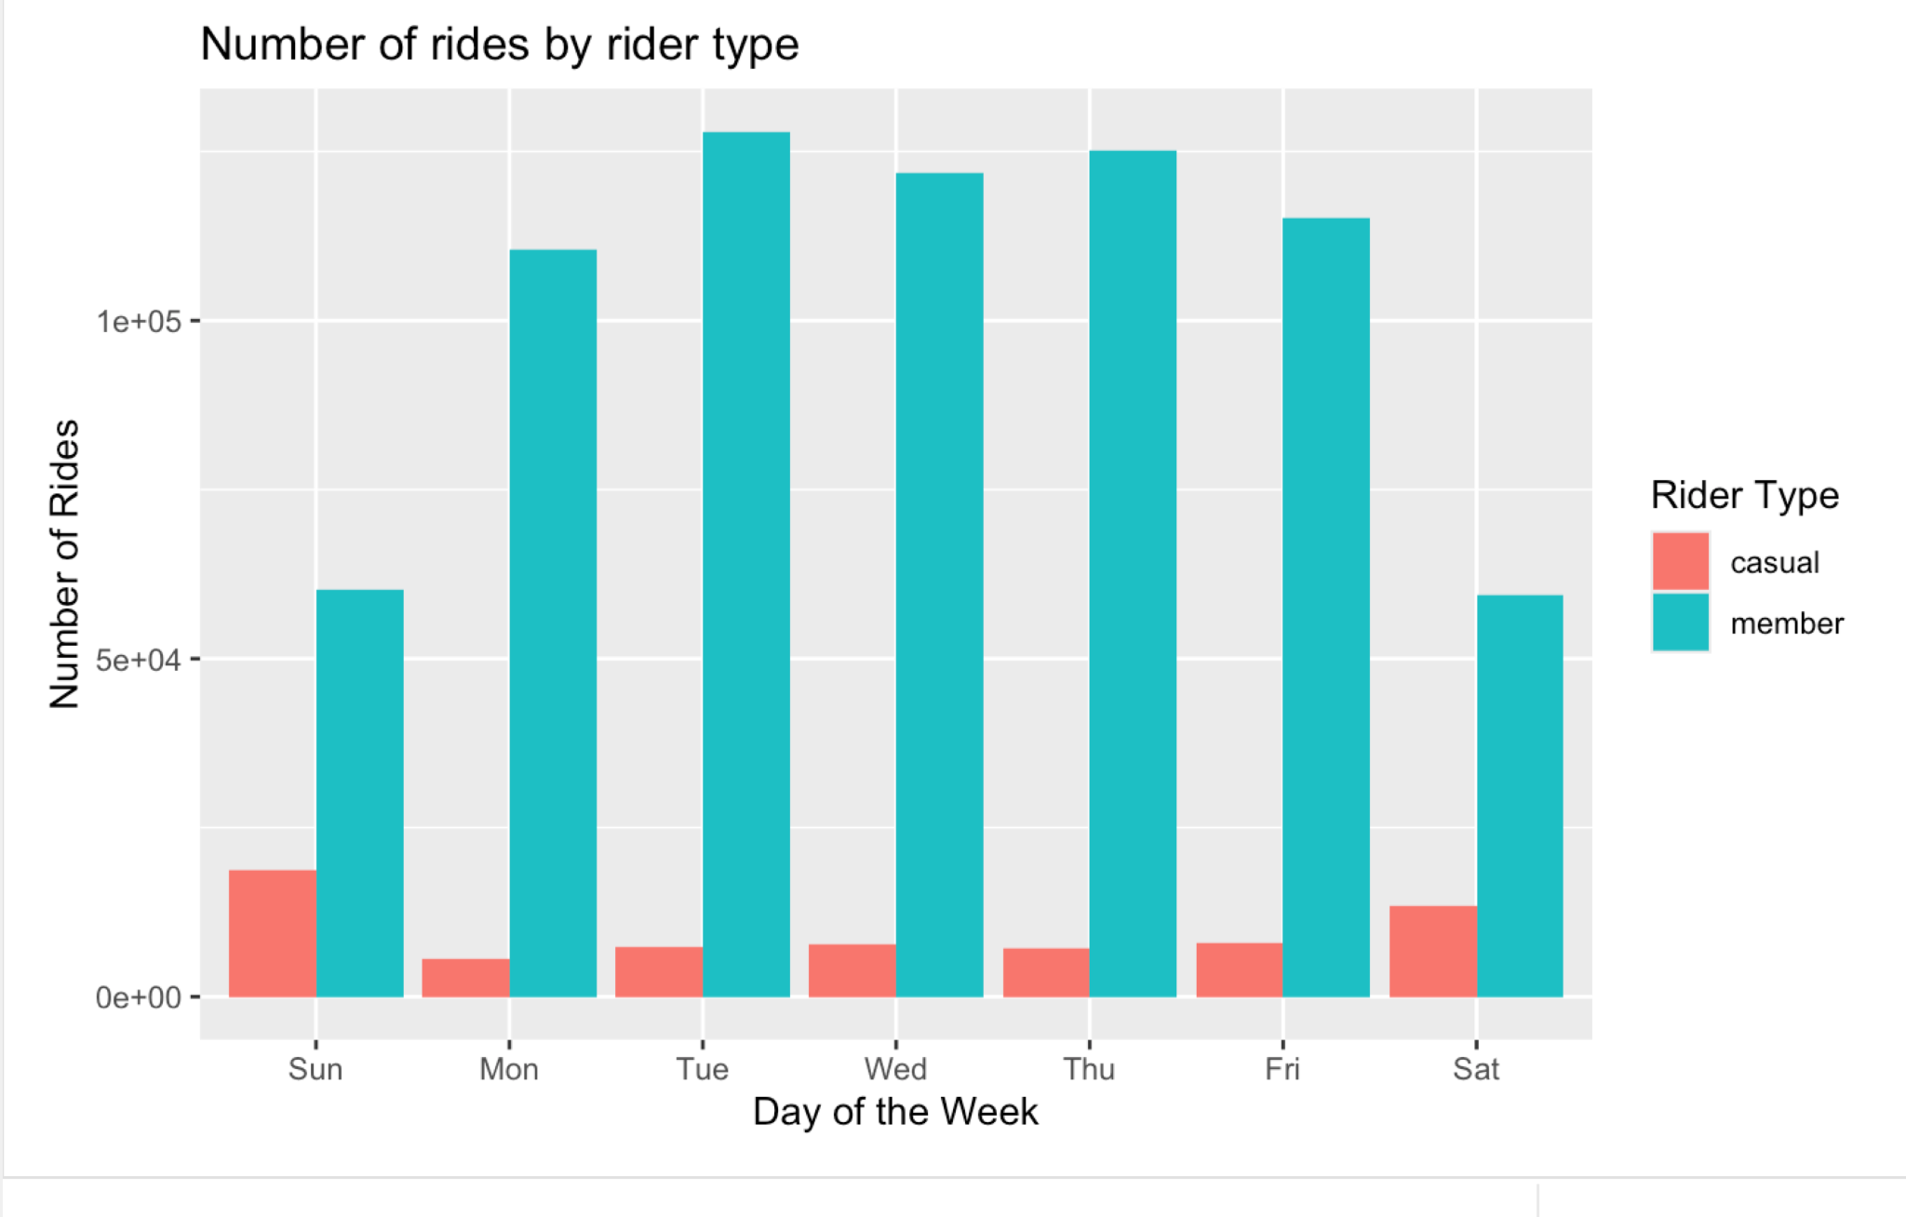
Chart

Slide 10
Rider Analysis
Finance analysts have determine that annual members are more profitable than casual riders. Hence the need to target the casual riders in a campaign so as to convert as much casual riders to members.
The Casual riders, on the other hand tend to have a higher volume on weekends, suggesting more leisure -oriented use. The probably do not feel committed to a plan because they are not available all round the week.
66%
Members
Member have significantly more rides than casual riders on weekdays, indicating a stronger pattern of regular usage, potentially for commuting or other daily activities.
Volume of Rides
Casual
34%

Slide 11
Rider Analysis
Finance analysts have determine that annual members are more profitable than casual riders. Hence the need to target the casual riders in a campaign so as to convert as much casual riders to members.
Casual riders typically have much longer average ride durations compared to members, indicating that casual riders might use bikes for longer leisure rides or occasional trips
36%
Members
Members have shorter average durations, likely due to more frequent and utilitarian use, such as commuting.
Average Duration
Casual
64%

Slide 12

These insights are key for understanding rider behavior and can guide marketing strategies to convert casual riders into annual members. For example, highlighting the benefits of shorter, frequent rides for commuting might appeal to casual riders, encouraging them to consider membership. Similarly, understanding that casual riders tend to ride longer on weekends can help shape leisure-focused marketing campaigns.

Slide 13
Recommendations
To convert casual riders to annual members, Cyclistic Share Company can focus on creating a more compelling value proposition for annual memberships. Here are some recommendations based on the data analysis and observed usage patterns:
Targetted Messaging
Highlight the benefits of annual membership, such as cost savings, convenience, and exclusive perks. For example, emphasize that annual members pay a lower rate per ride compared to casual riders.
4
3
2
Usage Scenarios: Illustrate scenarios where membership adds value, such as daily commuting, regular weekend rides, and group rides with friends and family.
Customer Testimonials: Use stories from existing members to showcase how membership has improved their experience.
1
Tailored Marketing Campaigns

Slide 14
Recommendations (Cont.)
Weekend Promotions
Given that casual riders tend to ride more on weekends, Cyclistic could offer special promotions or incentives for casual riders who convert to annual memberships during the weekend. This could include:
4
3
2
Discountered Annual Membership: Offering a discount for annual memberships.
Weekend-Only Benefits:: Special benefits for new members who join during the weekend, such as free merchandise or additional ride time.
1
Weekend Promotions

Slide 15
Recommendations (Cont.)
Commuter incentives
Since members are more likely to ride on weekdays, Cyclistic could target casual riders with commuter-focused incentives to encourage membership. Consider:
4
3
Commuter Package: A special annual membership designed for commuters, including benefits like unlimited weekday rides, priority docking at commuter-heavy stations, or complimentary coffee at partner cafes.
Priority Access: Allow members early access to new bikes, exclusive docking stations,, or priority customer support.
2
1
Commuter Incentives

Slide 16
Recommendations (Cont.)
Exclusive Member Benefits
Create exclusive benefits for annual members to enhance the perceived value of membership. This could include:
4
3
Member-Only Events:: Organize bike tours, group rides, or social events exclusively for annual members.
Partner Discounts:: Collaborate with local businesses to offer discounts to annual members, such as restaurants, gyms, or entertainment venues.
Partner Discounts:: Collaborate with local businesses to offer discounts to annual members, such as restaurants, gyms, or entertainment venues.
2
1
Exclusive Member Benefits

Slide 17
Additional Data Needed for Analysis
Having information such as employment status and type of employment of the riders can give more insight into their ride pattern. This information could reveal their financial status, free time and how much they value spending time with family.
Employment Status
Job
Marital Status

Slide 18



Summary of Findings
The Cyclistic bike-share program in Chicago set out to identify differences in usage patterns between casual riders and annual members, with the goal of developing strategies to convert casual riders to annual members.
The analysis shows that there is a significant difference in the volume of rides and Annual members ride more frequently on weekdays, suggesting a commute-oriented usage pattern. Casual riders, in contrast, have higher ride volumes on weekends, indicating a tendency toward leisure activities. Also Casual riders have significantly longer average ride durations compared to annual members. This suggests that casual riders often take longer trips, while annual members tend to use the service for shorter, more frequent rides.
All Trips Ride Lenght
casual- 3859.9879
member- 218.9801

